Slide 1


IMDB MOVIE ANALYSIS
USING PYTHON (PANDAS, NUMPY, SEABORN, MATPLOTLIB)

Slide 2


OBJECTIVE
Analyze Genre Popularity: Explore the dataset to identify the most popular movie genres based on metrics like average user ratings, number of movies produced, and total box office revenue. Visualize trends using bar plots and heatmaps.
Examine Score Trends: Investigate how movie scores have evolved over time. Use line charts and distribution plots to highlight scoring patterns and correlations with factors such as release year, genre, and runtime.
Identify Success Factors: Analyze relationships between key variables (e.g., budget, director reputation, cast) and movie success metrics (e.g., IMDB scores, box office collections). Provide actionable insights through regression models and correlation matrices.

Slide 3
PROJECT SETUP AND DATA LOADING
1. Key Libraries for the Project
Pandas: Essential for data cleaning, manipulation, and analysis.
NumPy: Optimized for fast numerical computations and handling multidimensional arrays.
Matplotlib: Ideal for creating static, interactive, and animated visualizations.
Seaborn: Built on Matplotlib, it simplifies statistical data visualization with aesthetically pleasing plots.
2. Dataset Overview
Shape: (10178 rows, 12 columns)
  Rows: Each row represents a unique movie and its details.
  Columns: Include critical attributes like:
    Movie name, release date, score, and genre
    Overview, crew, and original title
    Status, original language, budget, revenue, and country of origin

Slide 4

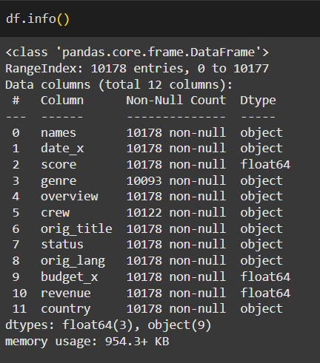
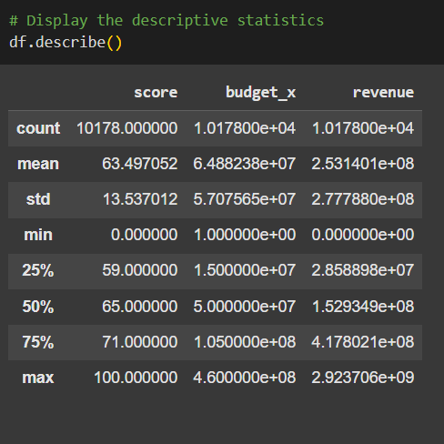
DATA OVERVIEW AND
BASIC EXPLORATION

Slide 5
1. Score Column:
  Mean: 63.50
  Median (50%): 65.00
  Std (Standard Deviation): 13.54
  Range: 0 to 100
The score distribution is roughly symmetric, albeit slightly left-skewed because the mean is lower than the median, as indicated by the closeness of the mean and median. The standard deviation shows some variation, but considering the small range (0-100), the majority of values probably cluster around the mean.
2. Budget x Column:
  Mean: $64.88M
  Median (50% ) $50M Std: $57.08M
  Range: $1 to $460M
The mean is higher than the median, suggesting a right-skewed distribution (a few very high-budget projects drive the mean up). The high standard deviation relative to the mean further supports the presence of extreme outliers in budgets.
3. Revenue Column:
  Mean: $253.14M
  Median (50% ) $152.93M
  Std: $277.79M
  Range: $0 to $2.92B
Because the mean is significantly higher than the median, the revenue column is likewise right-skewed, just like budget_x. Significant revenue variability is indicated by the very wide range and high standard deviation, which are probably caused by a small number of blockbuster movies with exceptionally high earnings.

Slide 6

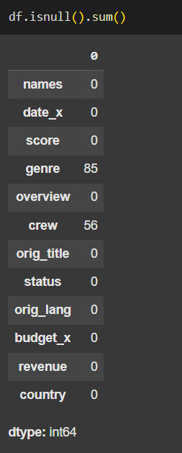
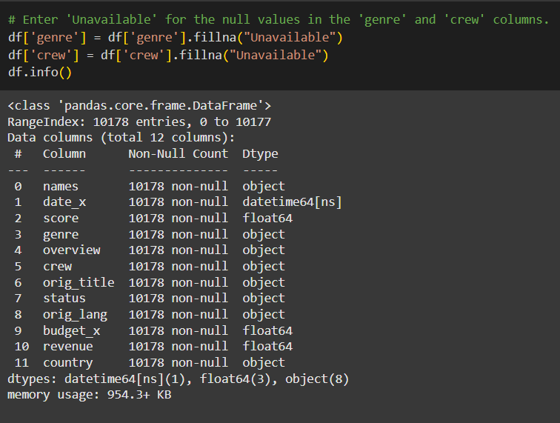

DATA CLEANING

Slide 7
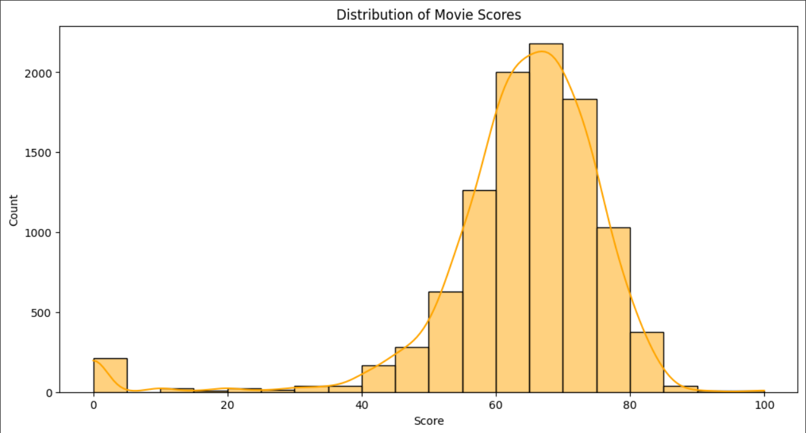
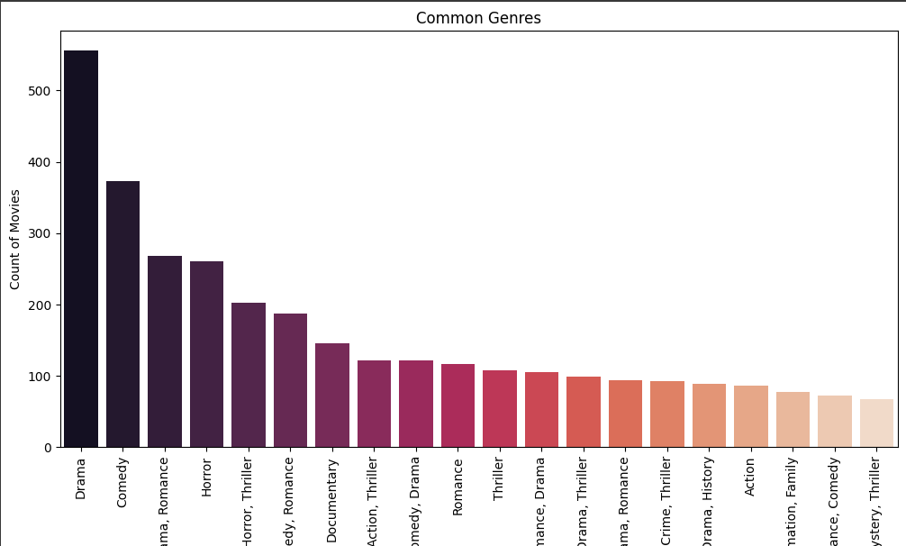
How are movie scores distributed? Draw a histogram and explain its form.
UNIVARIATE ANALYSIS
Which genres are most prevalent in the dataset? To illustrate their distribution, use a bar chart.

Slide 8
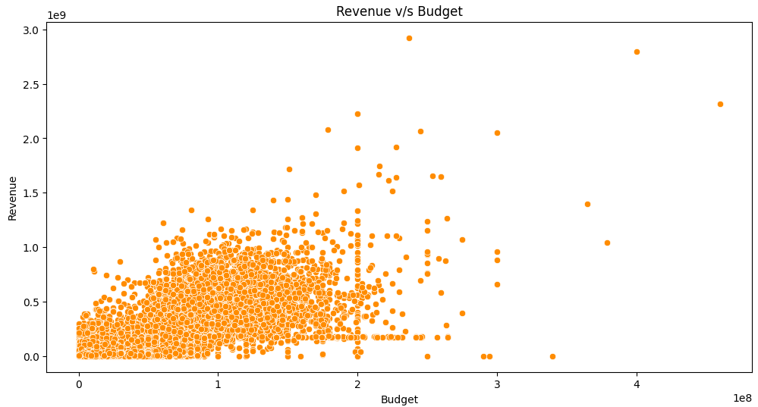
BIVARIATE ANALYSIS
Does the revenue of a film correlate with its budget? Create a scatter plot and describe any trends you see.
There is a noticeable positive trend where higher-budget movies generally achieve higher revenues. However, the relationship is not definitive, as a considerable variance suggests other factors also play a significant role.

Slide 9
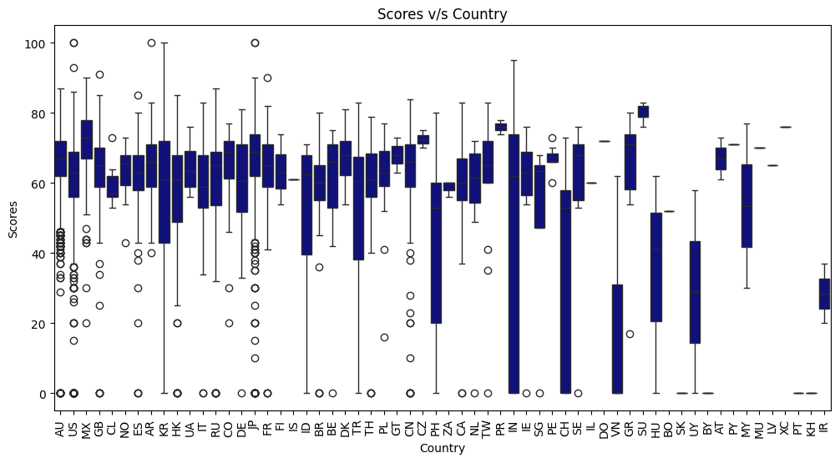
BIVARIATE ANALYSIS
Use a boxplot to compare movie score distributions across countries, revealing variations and outliers.

Slide 10
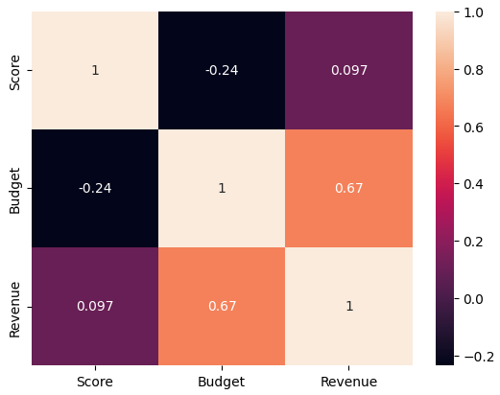
BIVARIATE ANALYSIS
Examine the correlation between movie scores, budgets, and revenues using a heatmap and correlation coefficients. This analysis reveals the strength and direction of relationships, offering insights into their impact on scores.
Score vs. Budget: A weak negative correlation (-0.24) suggests that higher budgets might slightly lower scores, but the relationship is minimal.
Score vs. Revenue: A very weak positive correlation (0.097) indicates little to no connection between scores and revenue.
Budget vs. Revenue: A moderate positive correlation (0.67) highlights that higher budgets often lead to greater revenues.

Slide 11
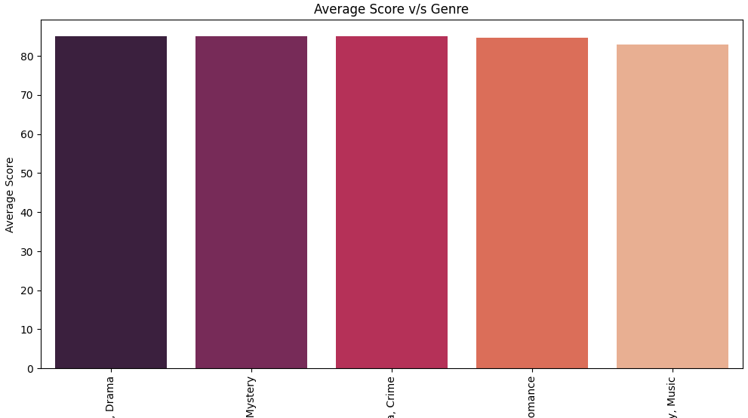
GENRE SPECIFIC ANALYSIS
Which genre has the highest average score? Calculate the avrage score for each genre and plot the results.
Fantasy, Drama and Crime is the genere with the highest average score.

Slide 12
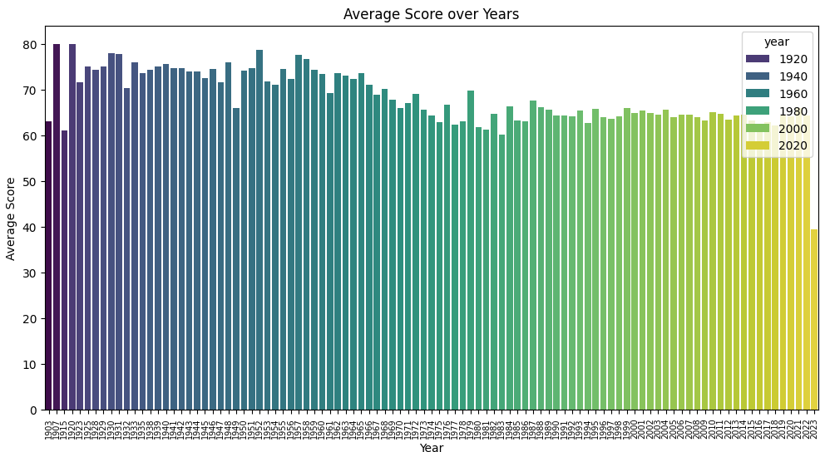
YEAR AND TREND ANALYSIS
How as the average score changed over the years? Plot the average score for each year.

Slide 13
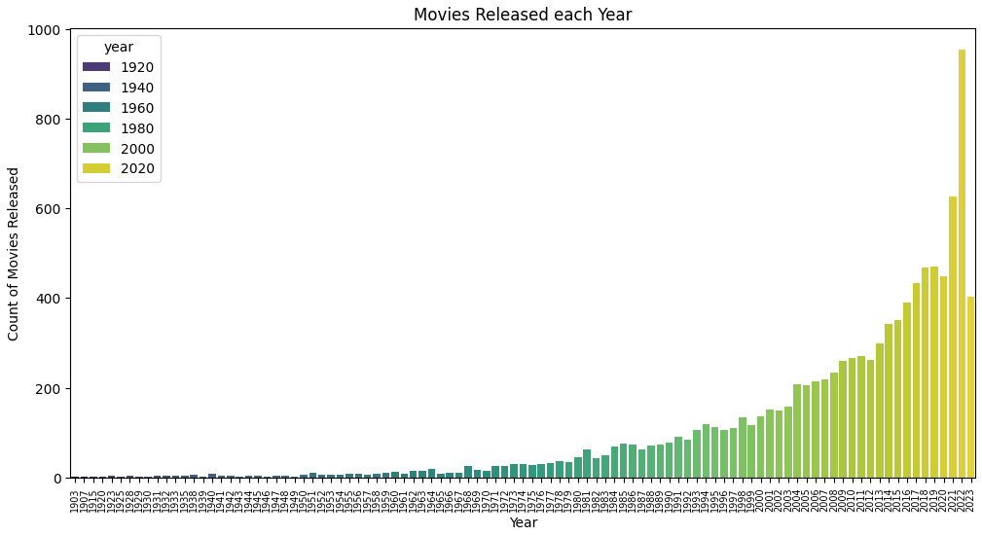
YEAR AND TREND ANALYSIS
Which years had the highest and lowest number of movie releases? Plot the number of movies released each year.
Year with the highest number of movies releases 2022
Year with the lowest number of movies releases 1903

Slide 14
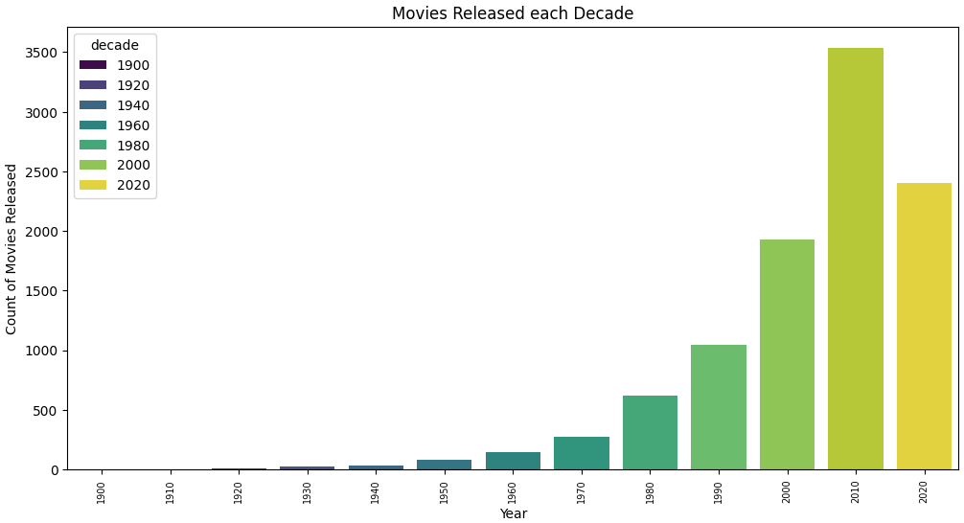
YEAR AND TREND ANALYSIS
Plot the number of movies released each decade.
2010 decade saw the most number of movies releases[3553].

Slide 15
INSIGHTS AND SUMMARY
Key Insights from the Analysis
  -Genre Popularity: Action and adventure genres have steadily grown in popularity, fueled by advancements in special effects and global appeal. Meanwhile, genres like westerns and musicals have declined due to shifting audience preferences.
  Budget vs. Scores: High-budget films often receive higher ratings due to superior production quality and star power, though low-budget films with strong storytelling, like indie dramas, can achieve critical acclaim.
  Seasonal Trends: Movies released in summer or during holidays tend to earn higher ratings and revenues, as these periods are strategically chosen for blockbuster releases targeting broad audiences.
Additional Questions for Deeper Insights
  - Does higher revenue correlate with better IMDB scores?
  - Do movies with high scores consistently achieve box office success?
  - How do scores and revenues vary across different countries?
  - Which genres yield the best revenue-to-budget ratios, and what drives their success?

Slide 16

CONTACT ME
Email
Surendrakumawatnwh@gmail.com
LinkedIn
www.linkdin.com/in/surendra089
GitHub
https://github.com/Surendra089
Whatsapp
+91-6375986775

Slide 17

THANK YOU!

